Slide 1
Using the Ensemble Smoother to calibrate complex integrated hydrologic models
Ayman H. Alzraiee
California Water Science Center, U.S. Geological Survey
"Preliminary Information-Subject to Revision. Not for Citation or Distribution."

Slide 2
Presentation Outline
Review strengths and limitations of different calibration methods.
Data assimilation (DA): justification, theoretical background, and numerical implementation.
Synthetic calibration problem to demonstrate strengths of DA.
Case Study: Calibrating Yucaipa Integrated Hydrologic Model using Ensemble Smoother.

Slide 3
Introduction: Model Calibration
Manual Calibration – Trial and Error
Gradient-based Methods
PEST
UCODE
Data Assimilation-based Methods
Ensemble Kalman Filter,
Ensemble Smoother,
Ensemble Kalman Smoother

Slide 4
Gradient-based Calibration
Par1
Model
output
Par2
Gradient of the prediction error (simulated minus observed) must be computed for each parameter
The model must be run at least as many times as there are parameters.

Slide 5
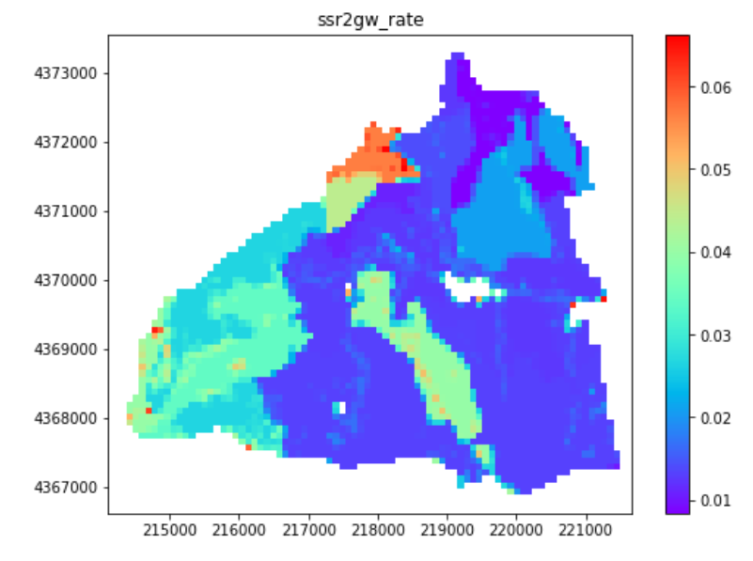
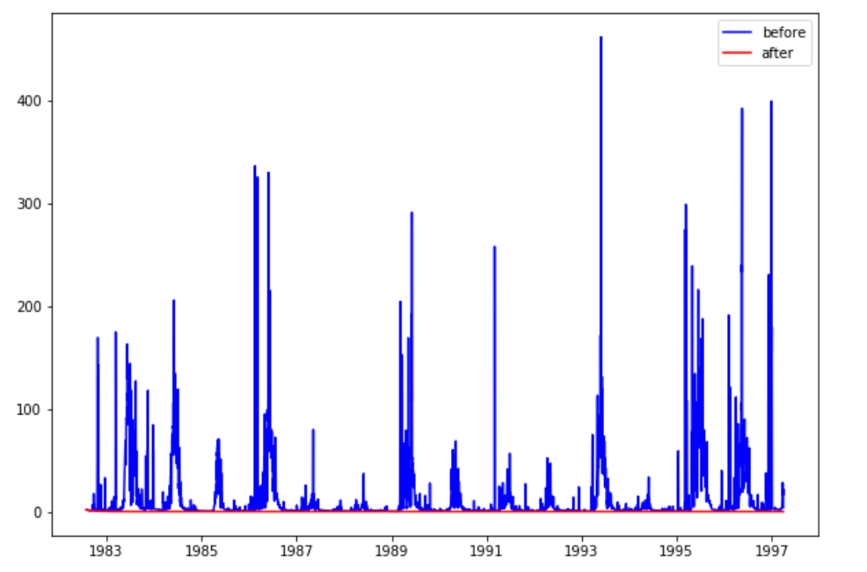
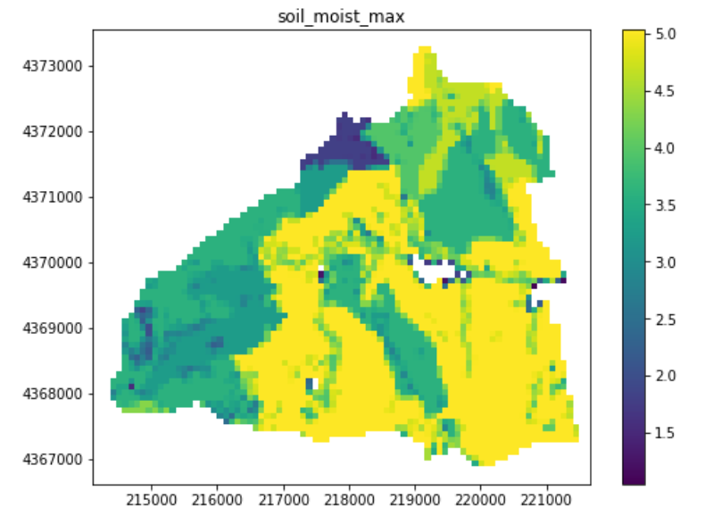
Introduction – The curse of Dimensionality
Distributed models requires the calibration of ~10⁵ -10⁶ of unknown parameters
Input
Spatially distributed parameters
Output
Stream flow
GSFLOW

Slide 6
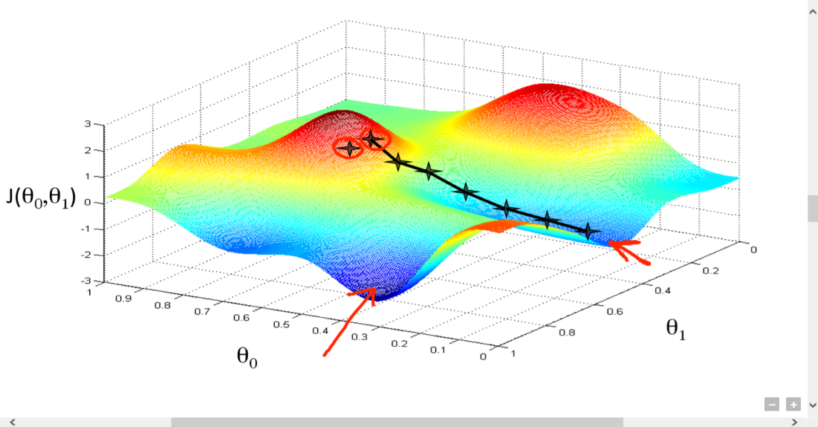
Multiple Local Minima
Local Minima
Global Minima
Gradient-based methods (Like Levenberg Marquardt method in PEST) are sensitive to the initial parameter values.

Slide 7
The problem of Non-uniqueness
Parameter set 1
Model
Output
Parameter set 2
Model
When the number of unknown parameters is larger than the number of observations, there is no unique solution for inverse problem.
Even when number of observations are more than number of unknown parameters , the inverse problem is still nonunique because of the unknown measurement errors.

Slide 8
Data Assimilation- Bayes’ Law
Likelihood
Prior
$$p\left(Parameters \right|Observations)= \frac{p\left(Observations | Parameters\right). p(Prior Parameter)}{p(Observations)}$$
The likelihood is function of the difference between simulated and observed values.
The prior can be seen as a set of initial parameters values that reflects our prior knowledge.
For Linear models and Gaussian input parameters there is a solution for Bayes’ law that is widely known as Kalman Filter.

Slide 9
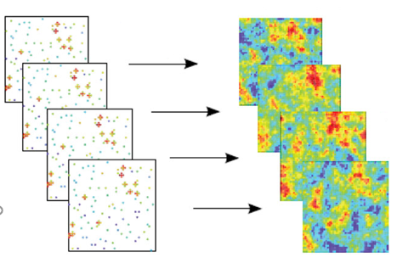
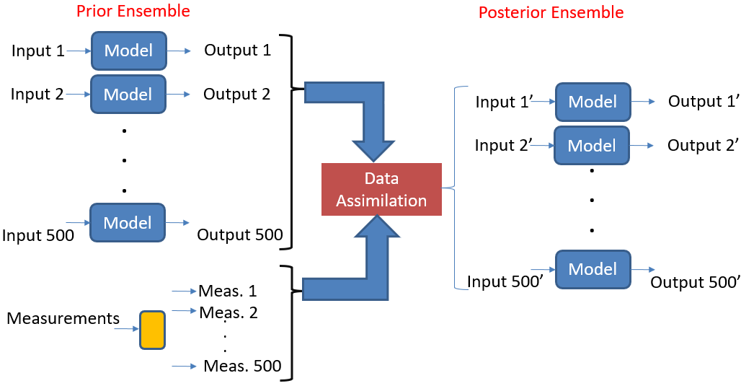
Ensemble-based Methods
Geostatistical Simulation

Slide 10





Kalman Filter
Calibrated Values
Initial Values
Innovation
$$K_{a}=K_{f}+C_{KH}^{f}\left(C_{HH}^{f}+R\right)(H_{o}−H)$$
$$K_{a}$$
Calibrated Parameters vector
$$K_{f}$$
Prior Parameters vector
$$C_{KH}^{f}$$
Prior Covariance of parameters and simulated observations
$$R$$
Covariance matrix of observation error
$$H_{o}$$
Observations vector

Slide 11
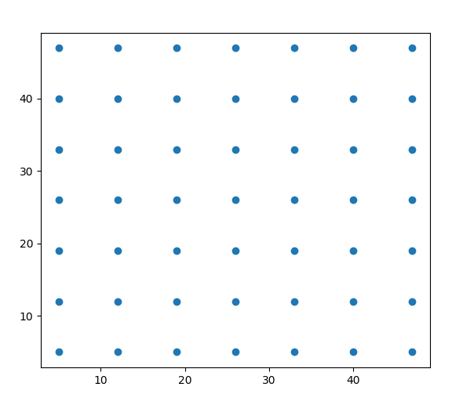
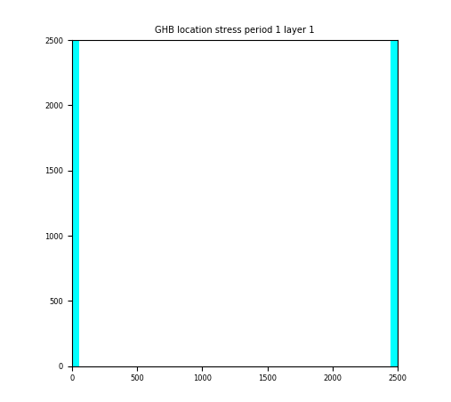
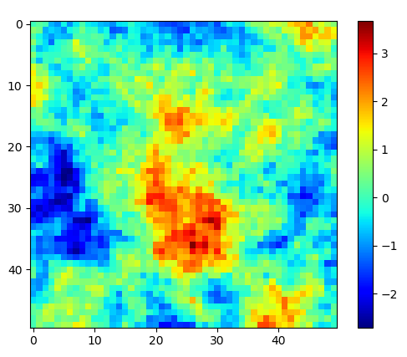
Synthetic Example – Pumping Test
Synthetic Model Settings
The goal is to estimate the hydraulic conductivity field at each cell.
200 random realizations for conductivity field are generated and simulated in the model.
Total number of unknown parameters is 2500.
Observation Wells
Boundary Conditions
Actual Conductivity Field
Log(m/day)
Pumping Well

Slide 12
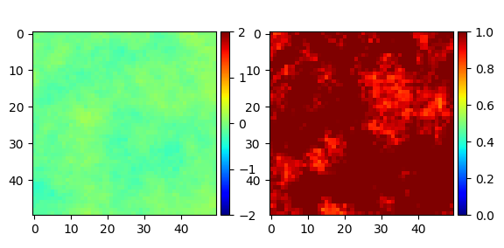
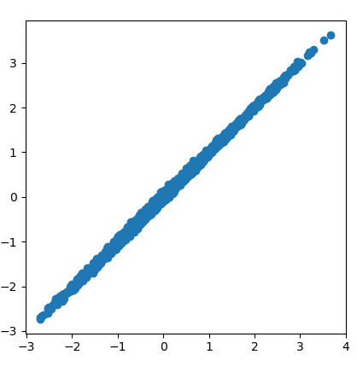
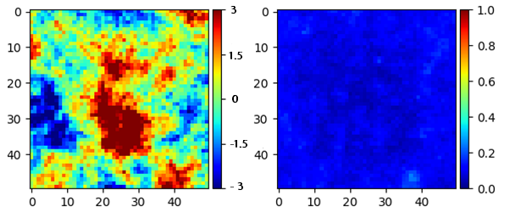
Calibration Results
Ensemble STD
(Estimation Uncertainty)
Actual K Field
Ensemble Mean
Before Calibration
Log(m/day)
After Calibration
Calibrated K Field
Log(m/day)
Actual K Field
Log(m/day)

Slide 13
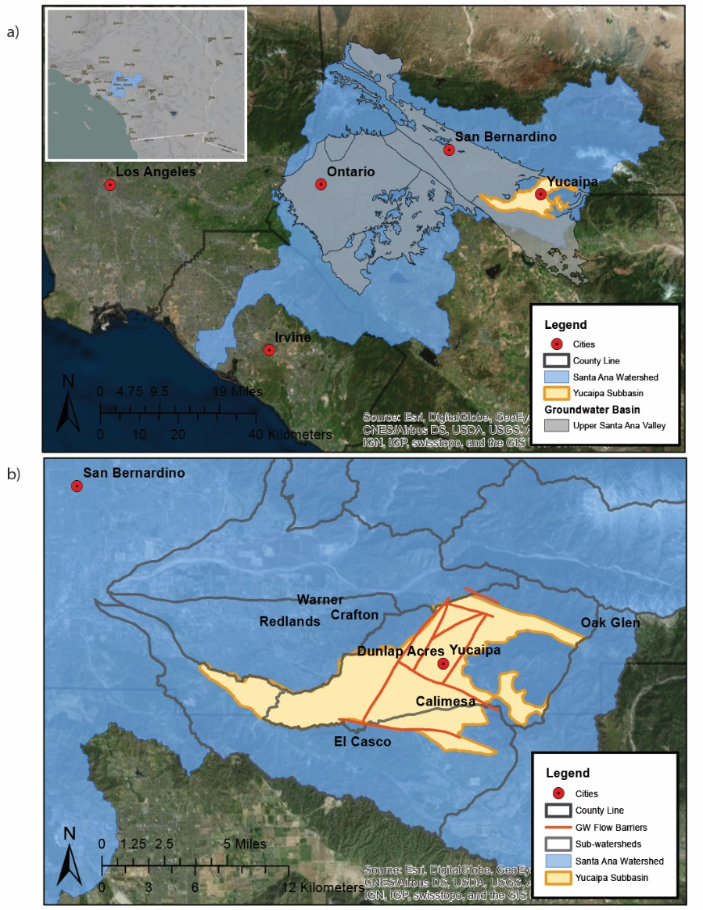
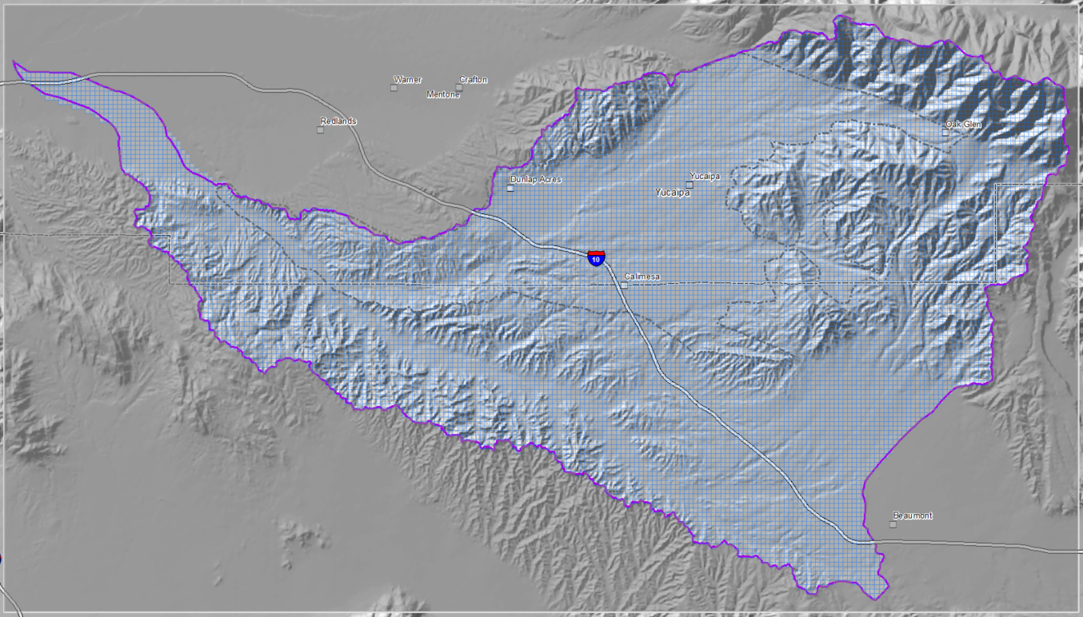
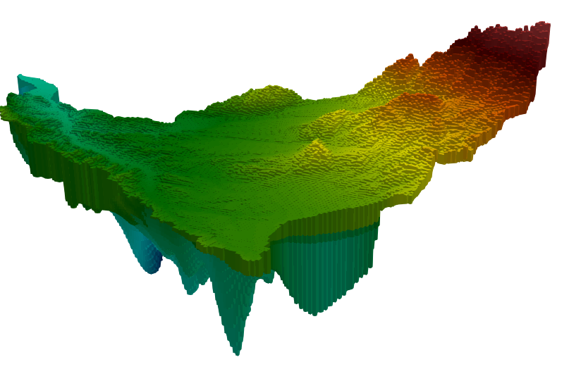
Calibration of Yucaipa Integrated Hydrologic Model
21.8 miles
12.17 miles
"Preliminary Information-Subject to Revision. Not for Citation or Distribution."

Slide 14
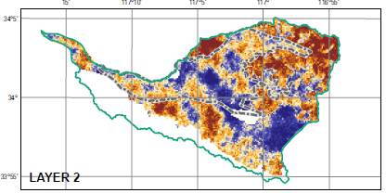
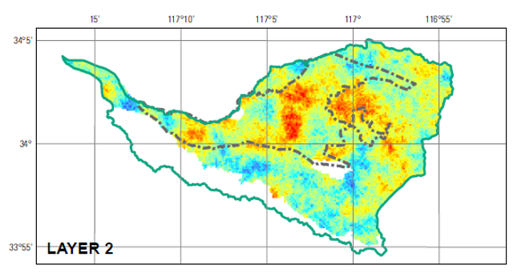
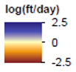
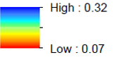
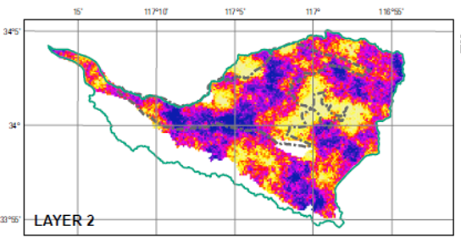
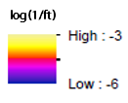
Calibrated Hydraulic Properties Fields
Hydraulic Conductivity
Specific Yield
Specific Storage
"Preliminary Information-Subject to Revision. Not for Citation or Distribution."

Slide 15
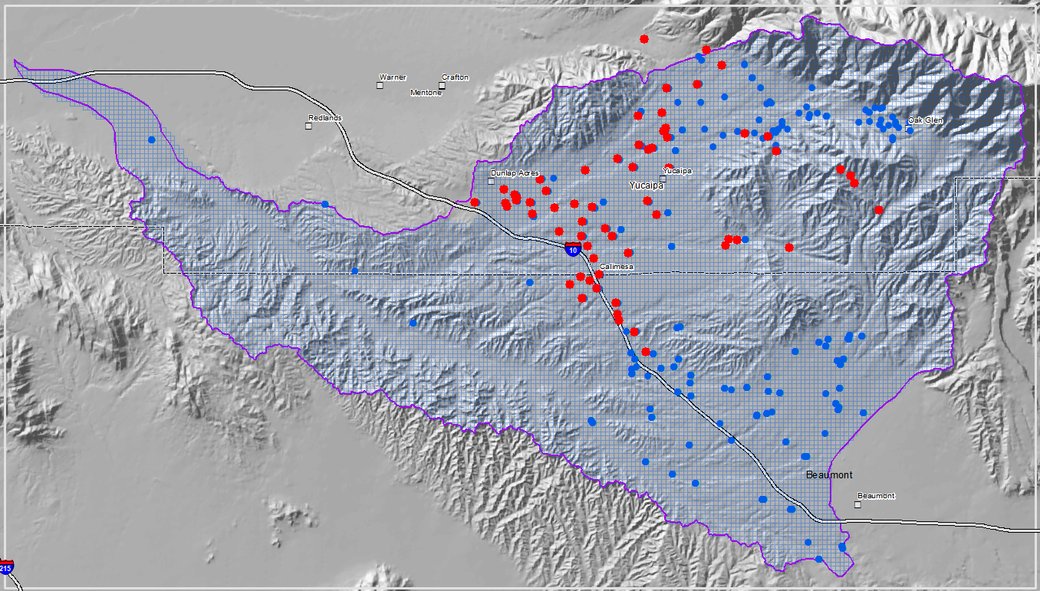
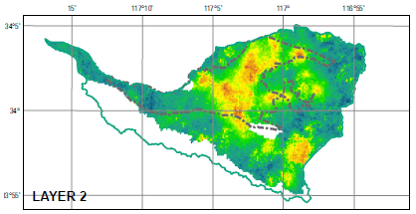
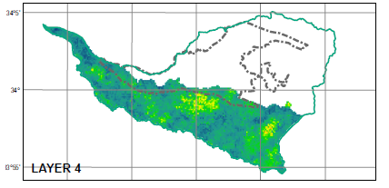
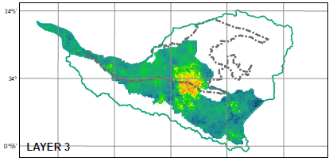
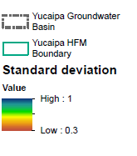
Predictive Uncertainty
"Preliminary Information-Subject to Revision. Not for Citation or Distribution."

Slide 16
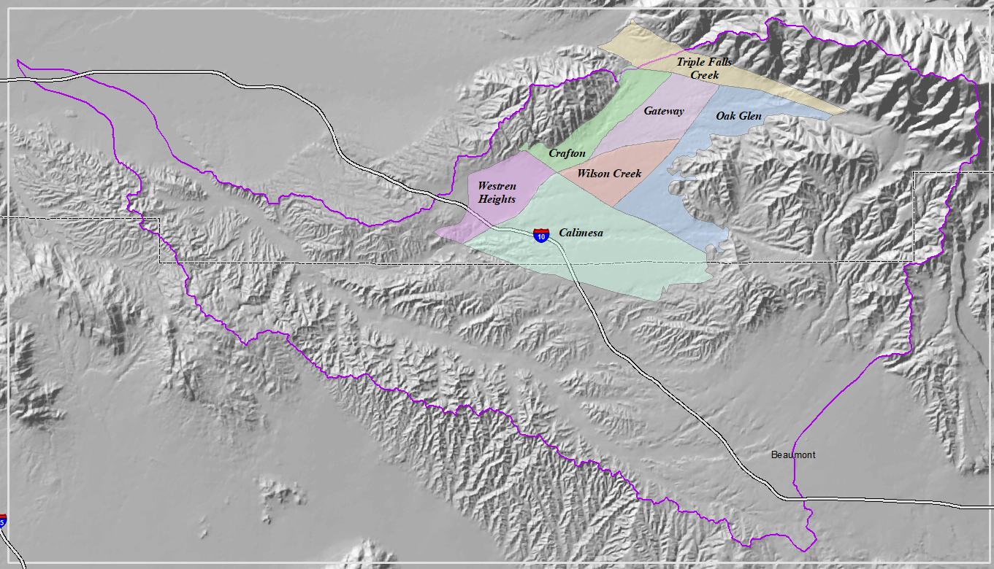
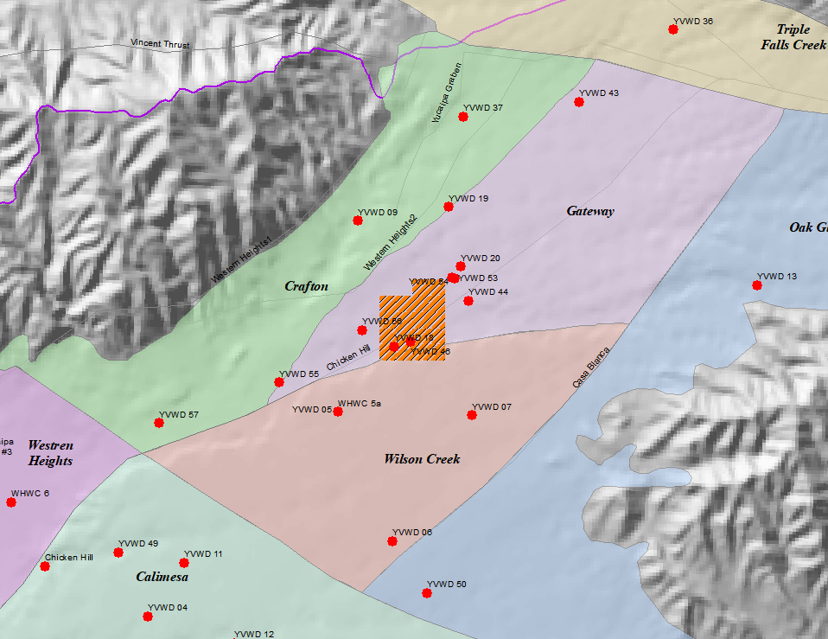
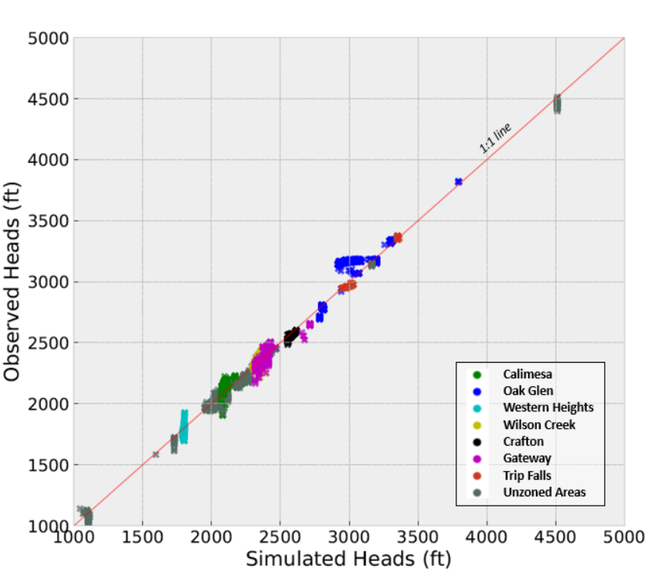
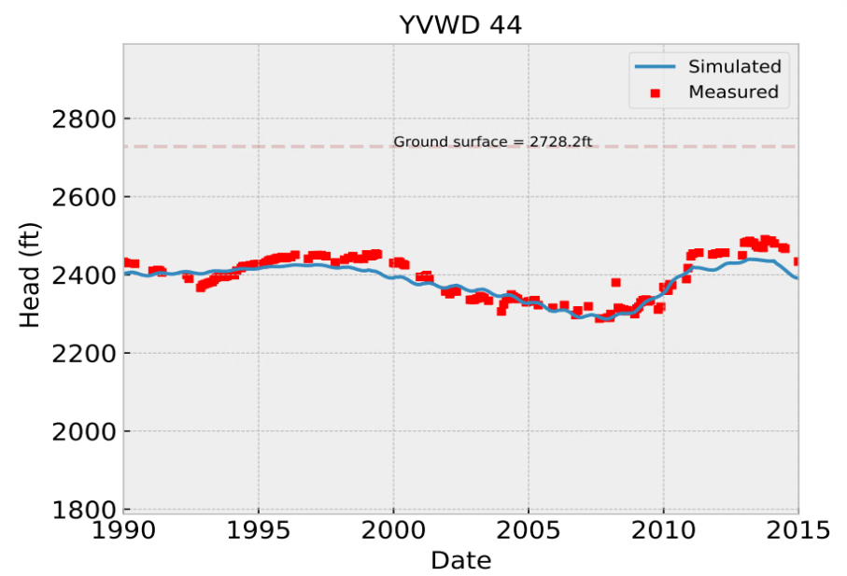
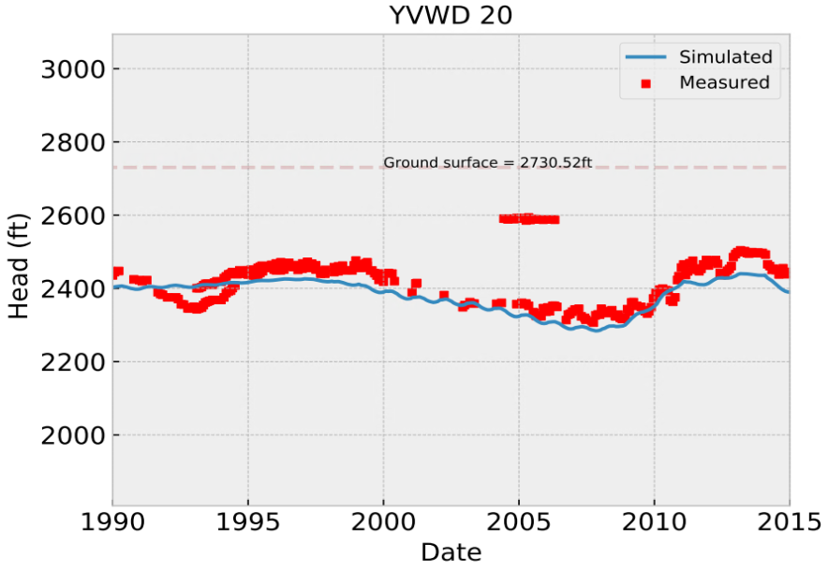
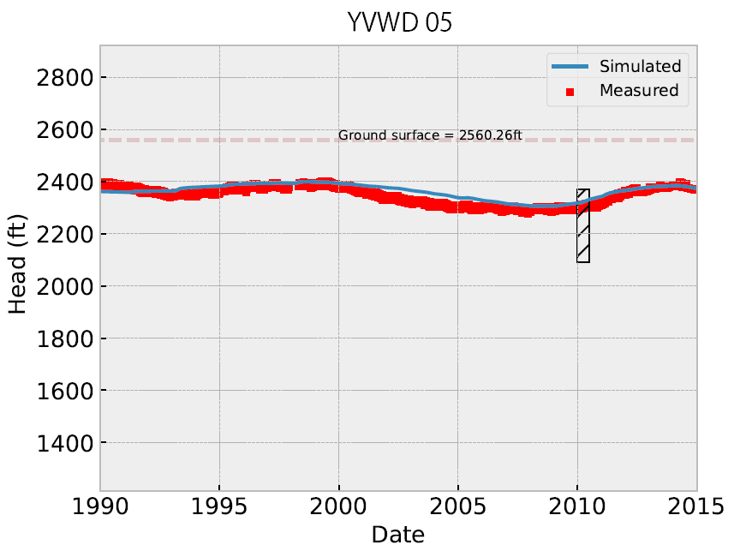
Model Fit
"Preliminary Information-Subject to Revision. Not for Citation or Distribution."

Slide 17
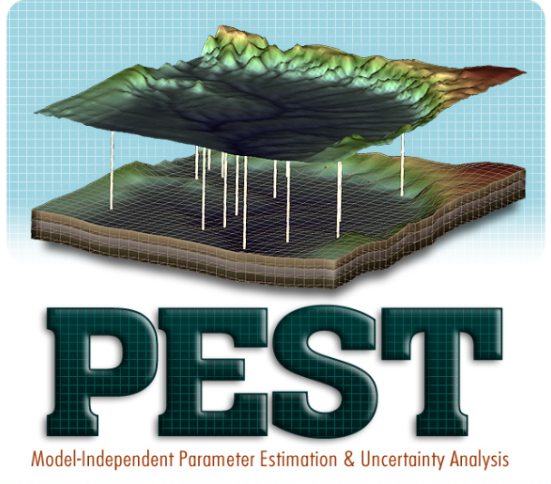
Model Independent Data Assimilation Package
Supported by the USGS Water Availability and Use Science Program, a model-independent PEST++ package is being developed to implement a wide range of data assimilation methods.
For PEST users the learning curve will not be steep. Input/output handling protocols in PEST is adopted for Data Assimilation Package.
Can do both model calibration and model forecast updates.
Project Repository
https://github.com/jtwhite79/pyemu
Team members:
Ayman Alzraiee, Jeremy White
Michael Fienen, Randal Hunt

Slide 18
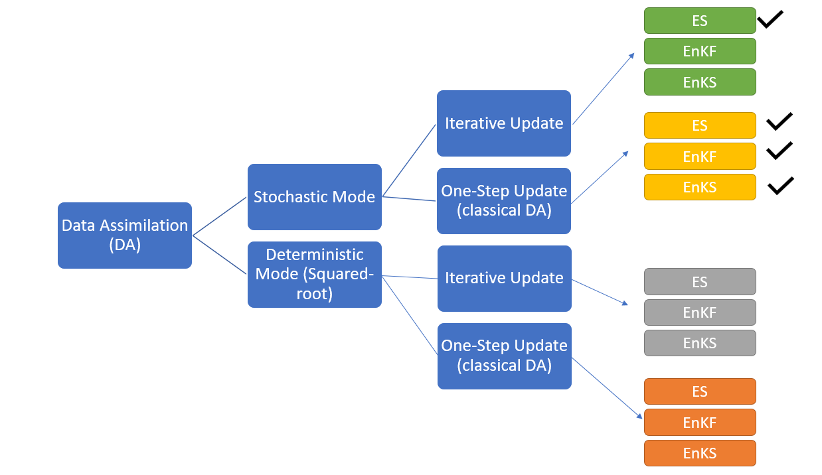
DA Methods Support PEST-KF

Slide 19
Summery
Data assimilation (DA) combines data and model predictions within probabilistic framework to get the best estimate of unknown input parameters and model output.
Ensemble-based DA can be used to calibrate high-dimensional parameters (~10⁶ unknown parameters and their uncertainty).
Iterative Ensemble-based DA is an active area of research to benefit from the strengths of both Gradient-based methods and DA methods.

Slide 20
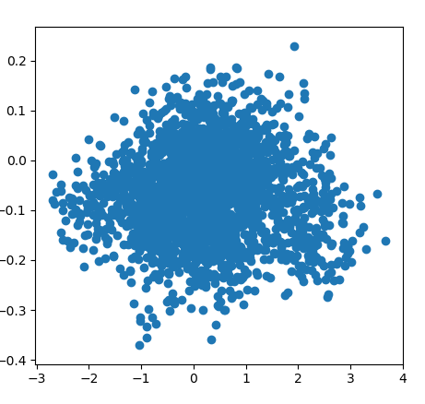
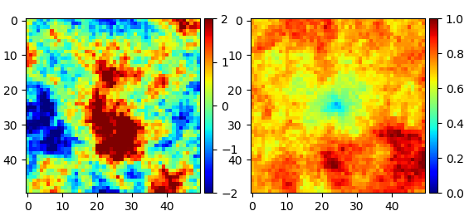
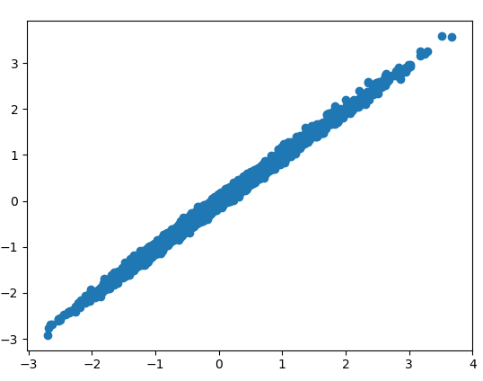
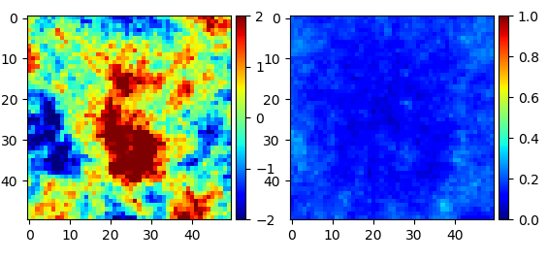
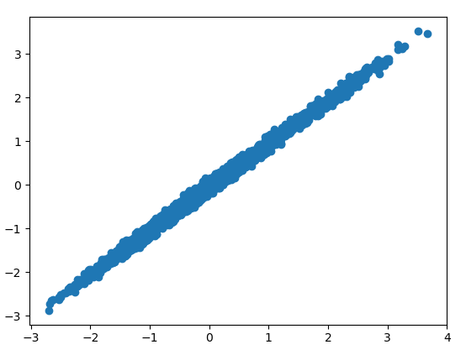
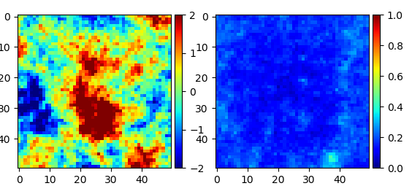
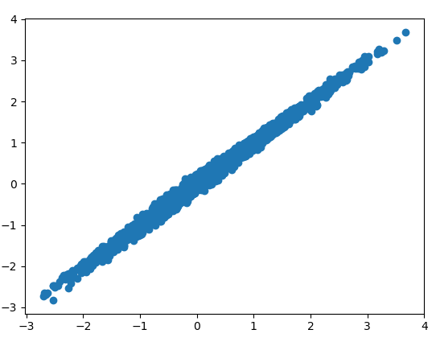
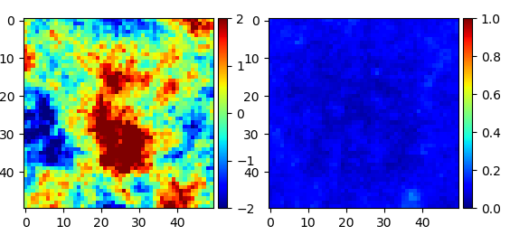
Ensemble Kalman Filter
Ensemble Mean
Ensemble STD
Cycle 1
Cycle 2
Cycle 3
Cycle 4

Slide 21
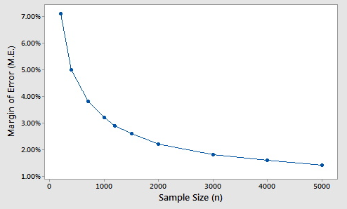
Advantages of Data Assimilation Methods
An ensemble of initial parameter values (Prior Ensemble) are used.
Forward runs (Sample size N) is much smaller (m~10²) than the number of the unknown parameters (n~10⁶).
Uncertainty Quantification (UQ) is built-in the data assimilation.
O(1/N)

Slide 22
More than Parameter Calibration…
Time: 0
Model
Model Predictions
Time: 1
Initial States
Kalman Filter
Observations at time 1
Time: 1
Model
Model Predictions
Time: 2
Initial States
Kalman Filter
Observations at time 2
Time: 2
Model
Model Predictions
Time: 3
Initial States
Ensemble Kalman Filter

Slide 23
Type of Kalman Filters
Ensemble Kalman Filter
Ensemble Kalman Smoother
Ensemble Smoother
Modified from (Evenson, 2003)

Slide 24
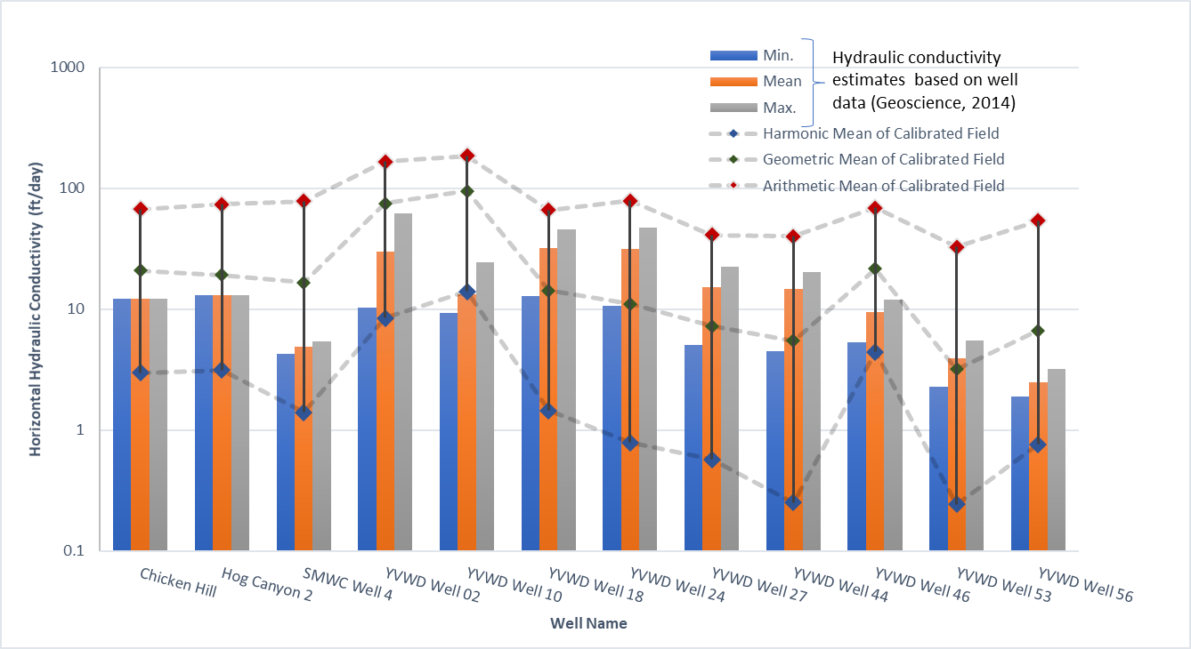
Comparing calibration results with estimates from pumping tests

